Slide 1

Programmatic advertising
Presented by
JAHNAVI akuri

Slide 2
AGENDA
PROGRAMMATIC ADVERTISING
RTB MECHANICS
AD TECH LANDSCAPE
STACKADAPT’S VALUE ADDITION
DATA OVERVIEW
FORECAST ANALYSIS
MARKET INSIGHTS
SUMMARY

Slide 3
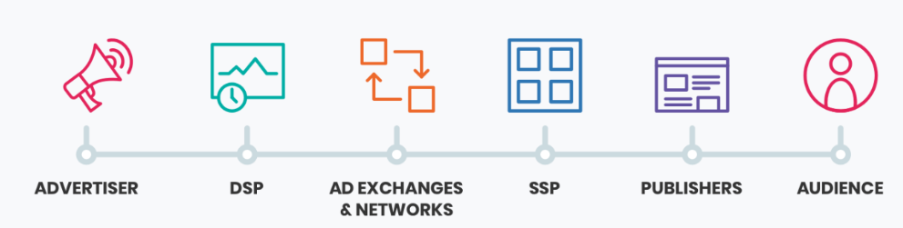
Programmatic advertising
Programmatic advertising is a system that automates the processes and transactions involved with purchasing and dynamically placing ads across the internet.
Advertisers use DSPs (Demand-Side Platforms) to bid on ad inventory via Ad Exchanges, targeting the right audience. Publishers use SSPs (Supply-Side Platforms) to offer their inventory, the winning ad is shown to the user within no time
Categories:
Real-Time Bidding (RTB): Open to all buyers, highest bid typically wins.
Private Marketplace (PMP): Invite-only auctions, Higher-quality inventory
Programmatic Direct (Guaranteed Deals): Pre-negotiated, fixed-price deals with guaranteed impressions.

Slide 4
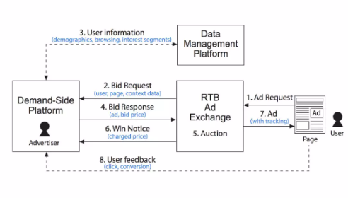
RTB MECHANICS
1:User Visits - A user loads a webpage that has an available ad placement.
2:Bid Request - Ad Exchange sends ad opportunity (user info, context data) to DSP
3:Data Management Platform - Additional user data (demographics, browsing interests) is added from DMP.
4: Bid Response - DSP decides on bid price, ad creative, and returns bid response
5: Auction - Ad Exchange instantly selects highest bidder (DSP)
6:Win Notice - Winning DSP is notified and pays slightly more than second-highest bidder’s price.
7: Ad Delivery - The winning ad is immediately served to the user on the webpage.
8: Performance Feedback - User interactions (clicks, conversions) tracked and fed back to DSP for optimization.
Notes:
1: User Visits - A user loads a webpage that has an available ad placement.
2: Bid Request -The webpage alerts an RTB Ad Exchange, sending a "Bid Request" that includes information such as user location, page type, and ad format.
3: Data Enrichment from Data Management Platform (DMP)-The exchange enriches the request by adding user information from a DMP, including demographics, browsing history, and interests.
4: Demand-Side Platforms (DSP) - The DSP evaluates the enriched data in milliseconds and decides if it matches the targeting criteria.DSP sends back a "Bid Response," specifying the ad to be displayed and the price it's willing to pay.
5: Auction -RTB Ad Exchange runs an auction instantly, selecting the highest bidder.
6: Win Notice-The winning DSP is notified ("Win Notice"), confirming the exact price they'll pay (usually just above the second-highest bidder).
7: Ad Delivery-The winning ad is immediately served to the user on the webpage.
8: User Feedback (Post-Ad Interaction)
After the ad is shown, user interactions (clicks, conversions) are tracked.
This data is sent back to the DSP to optimize future ad buying decisions.

Slide 5
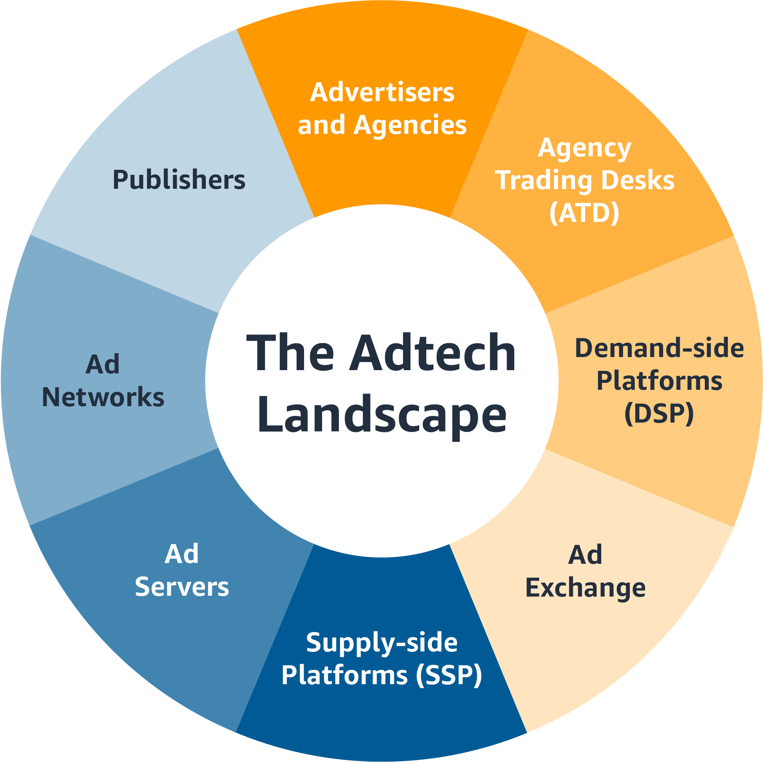
THE ADTECH LANDSCAPE
Category | Role in Ecosystem | Key Players
Demand-Side Platforms (DSPs) | Platforms used by advertisers/agencies to buy ads programmatically. | StackAdapt, The Trade Desk, Google Display & Video 360, Amazon DSP, MediaMath, Xandr
Supply-Side Platforms (SSPs) | Platforms used by publishers to sell and manage their ad inventory | Magnite, PubMatic, OpenX, Index Exchange, Sovrn, Google Ad Manager
Ad Exchanges | Digital marketplaces for real-time auctions between DSPs and SSPs. | Google AdX, OpenX, Xandr, Index Exchange
Data Management Platforms (DMPs) | Systems for collecting, analyzing, and managing audience data | Oracle BlueKai, Adobe Audience Manager, Lotame, Neustar, LiveRamp
Identity & Measurement Providers | Providers offering user data, and verification services in a privacy-focused environment. | LiveRamp (ATS), The Trade Desk (Unified ID 2.0), Integral Ad Science (IAS), DoubleVerify, Nielsen, Comscore

Slide 6
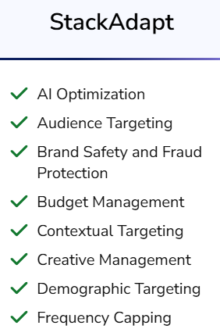

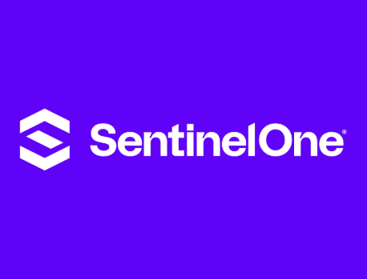



StackAdapt’s Value ADDITION
Agencies/Brands | Value provided
 | Havas People Lifts Sanofi’s Careers Page Traffic by 141%
 | Securing Conversions and Exceeding CPA Goals With B2B Targeting
Q3 | Amplifying B2B Engagement With a Multi-Channel Strategy
 | Popeyes Increases ROAS by 680% With StackAdapt’s Strategy
 | Corendon Airlines Increases Sales by 57% YoY With StackAdapt

Slide 7
Data overview
Aspect | Spend Data (Q3) | Performance Data (Q4) | eMarketer Ad Spend
Time Frame | Nov 2019 – Oct 2020 (12 months) | Nov 2019 – Oct 2020 (12 months) | Video (US, 2020–2024) Display (US, 2020–2024) Native (US, 2017–2021) Connected TV (CTV) (US, 2020–2024) Overall Digital (US, 2019–2024)
Key Fields | - Month - Format (Display, Video, Native, CTV) - Spend, Impressions, Clicks - CPM, CTR, engagement rate | -Months - Format (Display, Video, Native, CTV) -Ad Category - Engagement Rate, Conversion Rate - CTR, Viewability, Completion Rates | -Annual spend (USD billions) -Year-over-Year growth rates (%)
Use Cases | - Track & forecast spend trends - Assess budget allocation & cost efficiency | - Measure user engagement & interaction quality - Optimize targeting and creative strategies | Industry benchmarking Budget allocation & strategic planning Improving audience reach and ad effectiveness.

Slide 8
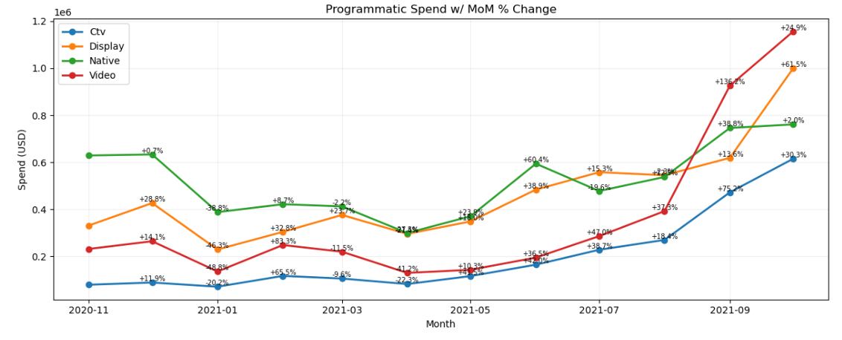
Spend Projections for Next 12 Months
Approach(Using Python):
Step 1: Load & Clean the given data
Step2 : Aggregate monthly spend by Format
Step 3: From eMarketer graphs set growth rates using YOY%
Step 4: Forecast Next 12 months (NOV 2020-OCT 2021)
Step5 : Plot a graph (Spend vs MOM % Change)
Insights:
Format | Graph Observation | Likely Reason
CTV | +75.2% MoM growth in Sep 2021 (highest among all formats) | Rising popularity of streaming, shift from traditional TV, increased ad budgets
Video | Peaked at +136.2% MoM in Aug 2021 | Back-to-school & early holiday campaigns; engaging format for branding
Display | Steady growth, peaked at +61.5% MoM in Sep 2021 | Seasonal marketing ramp-up, retargeting strategies
Native | Decline in Q1, rebounded mid-2021 with double-digit growth | Q1 budget cuts followed by content-based ad focus in H2
Overall | Consistent growth trend from June to Sep 2021 | Post-COVID economic recovery, return of ad budgets, seasonal campaign planning

Slide 9
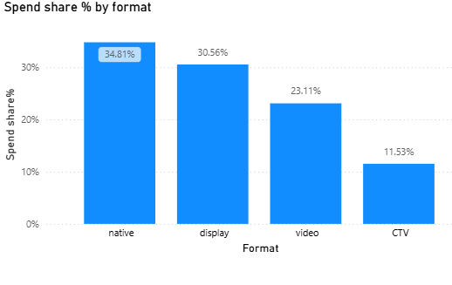
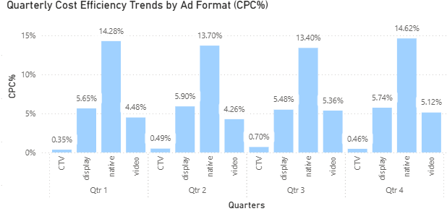
Market insights around spend data(power BI) --
Insight:
Native and Display ads received the highest budget share
CTV accounted for the lowest share ,indicating underutilization.
Takeaway:
Budget is heavily focused on Native and Display formats — review whether performance justifies this allocation.
Insight:
Native ads showed the highest CPC% across all quarters.
CTV remained the most cost-efficient format with <1%
Display and Video formats maintained moderate CPC%
Takeaway:
Native is increasingly expensive per click — shift spend toward more cost-efficient formats like CTV where performance is acceptable.
In

Slide 10
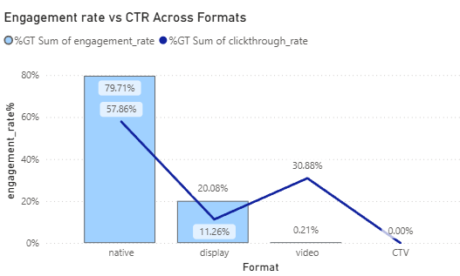
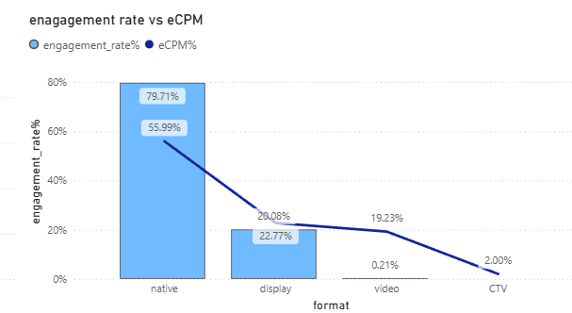
Market insights around spend data(power BI)
Insight:
Native outperformed with both high engagement rate (79.71%) and high CTR (57.86%), being the most effective format overall.
Display had moderate CTR (11.26%) but low engagement (20.08%), while Video and CTV underperformed in both.
Takeaway:
Native drives both immediate clicks and deeper interaction. Display may need creative or targeting optimization. CTV and Video need strategic reassessment.
Insight:
Native has the highest engagement and eCPM at 55.99%.
CTV has the lowest cost but have minimal engagement (2.00%).
Display provides moderate balance between cost (22.77%) and engagement (20.08%).
Takeaway:
While Native is impactful, it's costly. Evaluate ROI to justify premium. Explore improving engagement for low-cost channels like CTV.

Slide 11
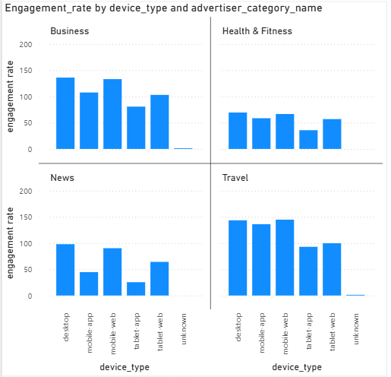
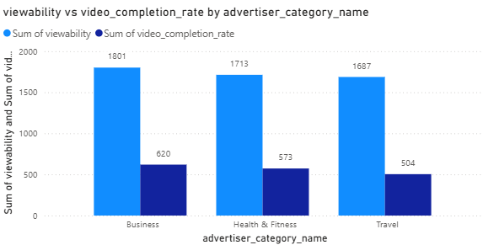
Market insights for ad category (power BI)
Insight:
Across all advertiser categories, mobile web and mobile app consistently deliver higher engagement rates than desktop or tablet.
Travel and Business advertisers see the most engagement on mobile app, while desktop underperforms for News and Health.
Takeaway:
Focus campaigns on mobile platforms for higher user interaction — especially for Travel and Business categories.
Insight:
All categories have high viewability (~1700–1800 range), but video completion rates remain low, especially for Travel (504).
Business performs best with 620 completions, indicating relatively better video performance.
Takeaway:
High viewability alone is not sufficient — optimize video content for completion and storytelling impact, especially in Travel.
.
.
In

Slide 12
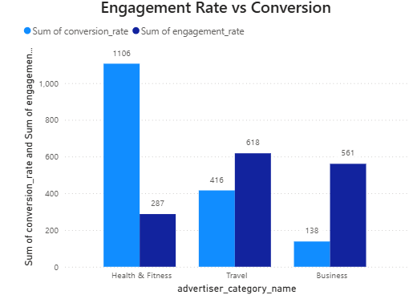
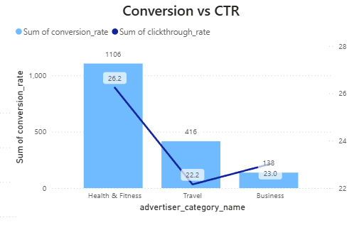
Market insights for ad category (power BI)
Insight:
Health & Fitness again dominates with the highest conversion (1106) and highest CTR (26.2%), indicating a strong ad-performance loop.
Business has a reasonable CTR (23%) but low conversions, highlighting a conversion drop-off.
Takeaway:
Health & Fitness is the most efficient category in both clicks and conversions. Its campaign structure can serve as a benchmark for optimizing underperforming categories
Insight:
Health & Fitness leads in conversions (1106) despite moderate engagement (287), suggesting highly effective targeting.
Travel shows balanced engagement and conversion, while Business has high engagement but very low conversion (138).
Takeaway:
High engagement ≠ high conversion. While Business ads generate interest, they struggle to convert — indicating potential issues with call-to-actions (CTAs) or landing page experience.
In

Slide 13
SUMMARY
Native & Display received the highest budget, but only Native delivered strong engagement and CTR. → Reassess Display performance; justify Native’s premium with ROI.
CTV showed lowest CPC & eCPM, yet lowest engagement. → Optimize creative strategy to improve performance on cost-efficient CTV.
Mobile platforms outperformed desktop in engagement ,especially in Travel & Business. → Prioritize mobile-first ad placements for better user interaction.
Health & Fitness category led in both CTR and conversions, despite moderate engagement. → Replicate its high-performing strategy to lower-converting categories like Business.
Notes:
1: User Visits - A user loads a webpage that has an available ad placement.
2: Bid Request -The webpage alerts an RTB Ad Exchange, sending a "Bid Request" that includes information such as user location, page type, and ad format.
3: Data Enrichment from Data Management Platform (DMP)-The exchange enriches the request by adding user information from a DMP, including demographics, browsing history, and interests.
4: Demand-Side Platforms (DSP) - The DSP evaluates the enriched data in milliseconds and decides if it matches the targeting criteria.DSP sends back a "Bid Response," specifying the ad to be displayed and the price it's willing to pay.
5: Auction -RTB Ad Exchange runs an auction instantly, selecting the highest bidder.
6: Win Notice-The winning DSP is notified ("Win Notice"), confirming the exact price they'll pay (usually just above the second-highest bidder).
7: Ad Delivery-The winning ad is immediately served to the user on the webpage.
8: User Feedback (Post-Ad Interaction)
After the ad is shown, user interactions (clicks, conversions) are tracked.
This data is sent back to the DSP to optimize future ad buying decisions.

Slide 14
THANK YOU

